Slide 1
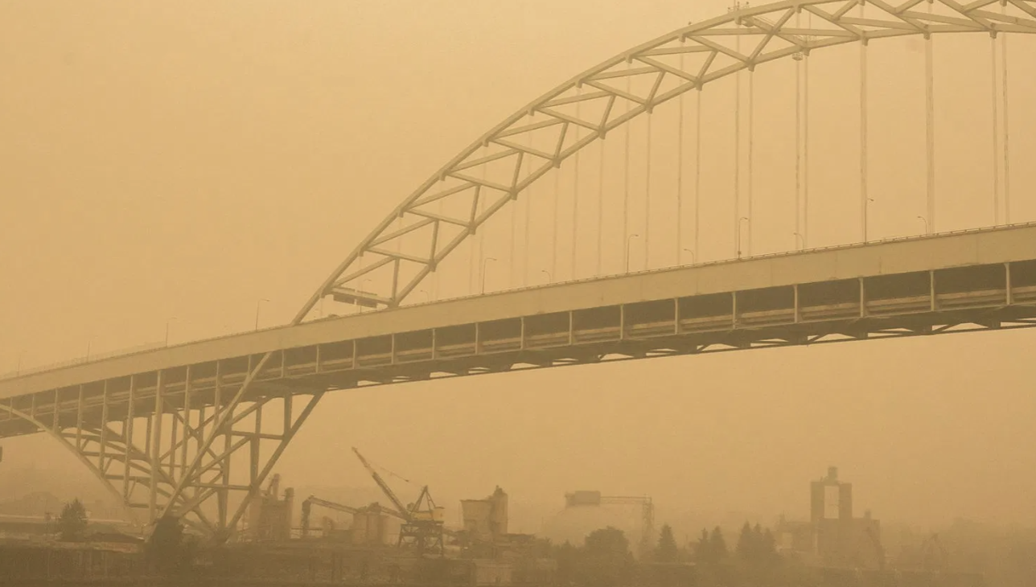
Using Data Science to Explore AQI Data
Last time…
We looked at some factors that affect the air quality index (AQI)
Open your work from last time to review what impacts AQI and why we care

Slide 2
What factors and chemicals affect AQI and why do we care?
Look at your work from last time and be ready to share.
Factors
Env Impacts
Human Impacts
Notes:
Teacher notes:
Have students talk in groups and then share what they know about these big ideas

Slide 3


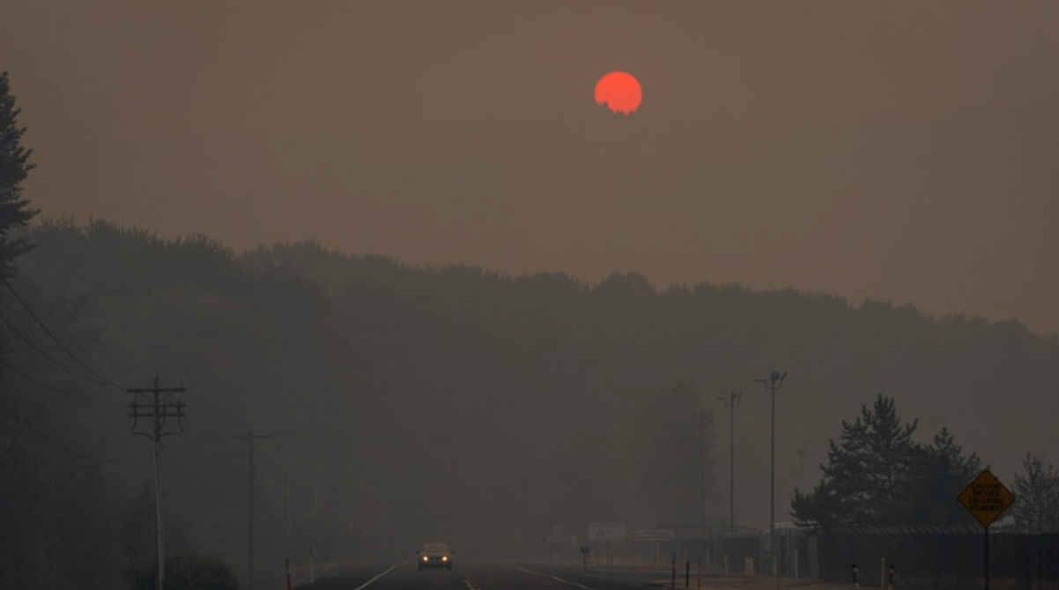
Which factor is causing images like these?
Notes:
Teacher notes:
These are all specific to the Portland, Oregon area with links to articles. Replace with images and links from your location.

Slide 4
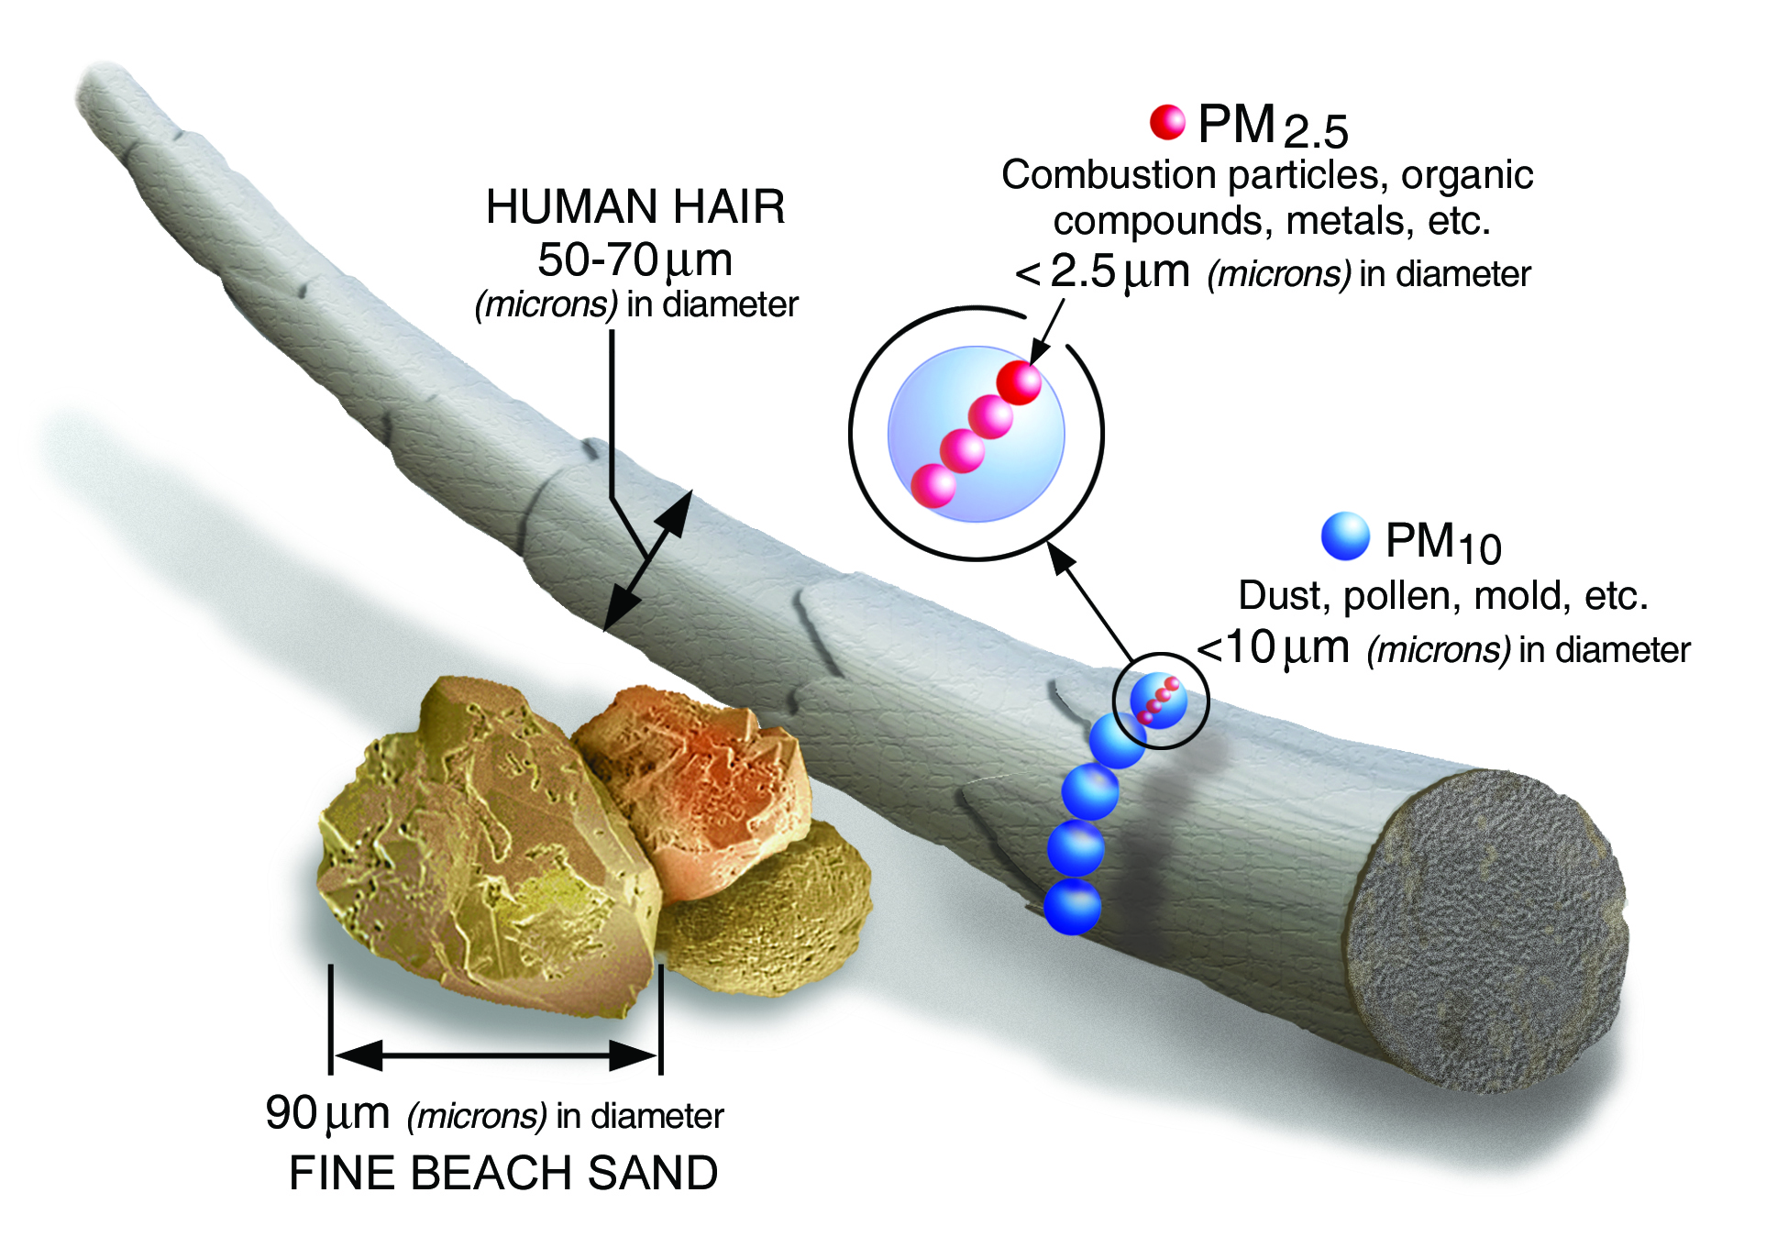
PM_{2.5}
What is it?
Particulate matter smaller than 2.5 micrometers
(0.001 mm)
Notes:
Teacher notes:
Zooming in on PM2.5 (over the next few slides) and why it matters. Students can answer the questions on each slide or teacher can deliver instruction.

Slide 5
PM_{2.5}
What causes it?
Dust storms, forest fires, fossil fuel combustion, construction sites, reactions with other pollutants

Slide 6
PM_{2.5}
Why do we care?
Asthma, allergies, heart attacks, decreased lung function, irritated airways, difficulty breathing, death

Slide 7
PM_{2.5}
Why do we care?
Depleted soil nutrients, acid rain, lake and river pH, nutrients in coastal waters and rivers, crop damage

Slide 8
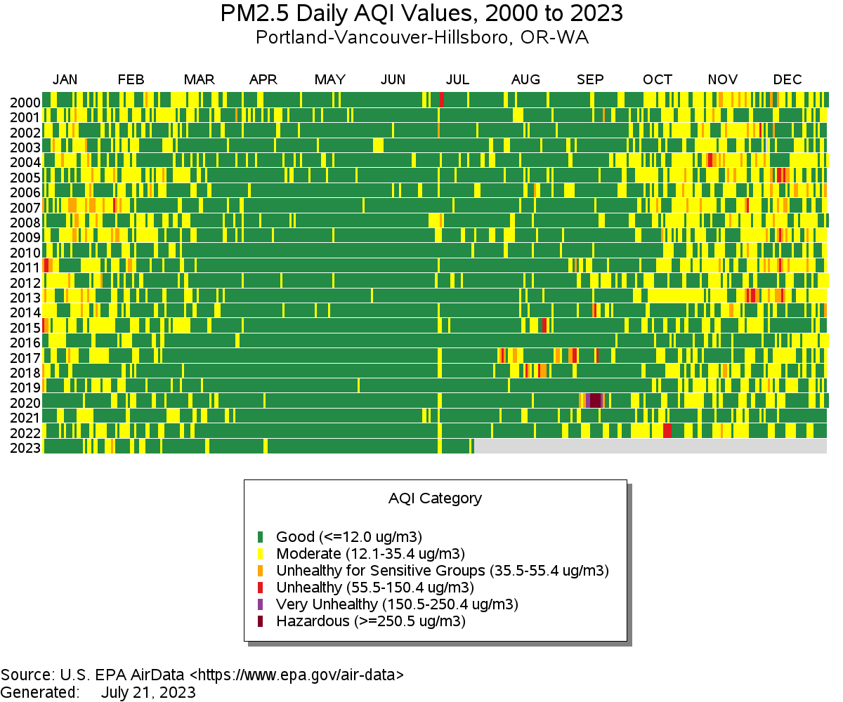
PM2.5 Daily AQI Values: Portland, OR & Vancouver, WA
What do you notice about the data?
What do you wonder about the data?
Notes:
Teacher notes:
Print color copies for students to examine in groups.
Ask them what they notice and wonder.

Slide 10
PM2.5 Daily AQI Values: Portland, OR & Vancouver, WA
What do you notice and wonder?
Notes:
Teacher notes:
Collect student responses here.

Slide 11
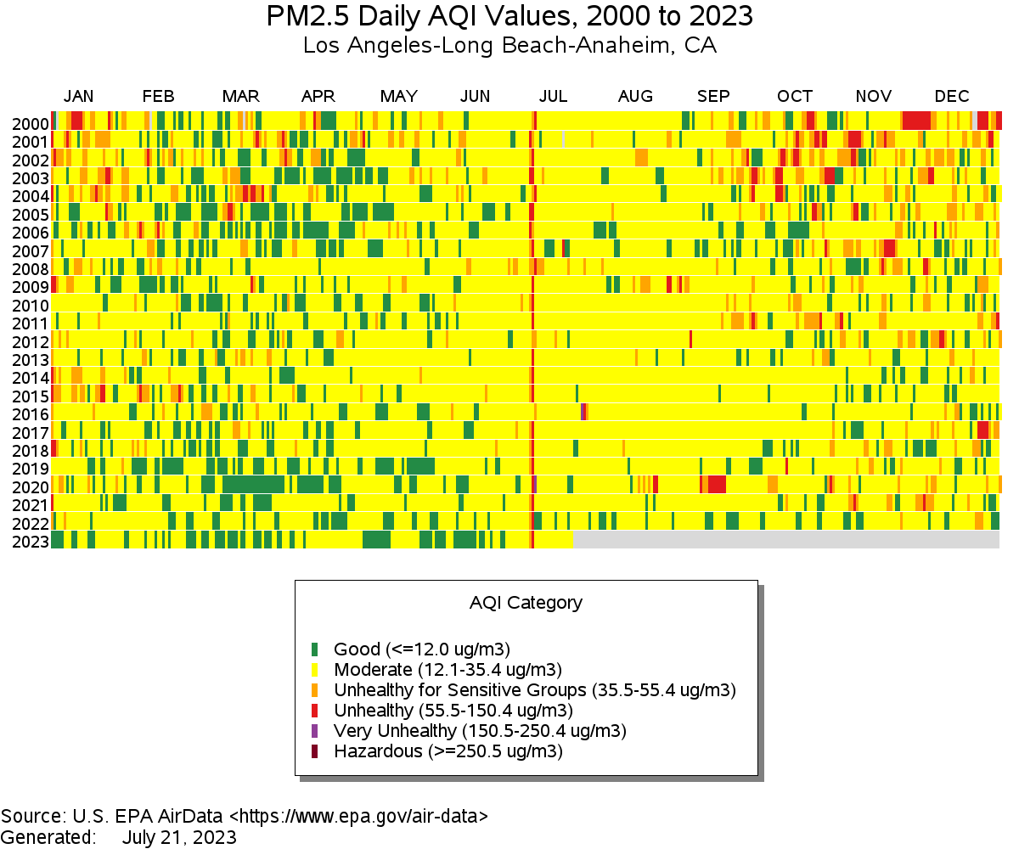
PM2.5 Daily AQI Values: Los Angeles, CA
What do you notice about the data?
What do you wonder about the data?
Notes:
Teacher notes:
Print color copies for students to examine in groups.
Ask them what they notice and wonder.

Slide 13
PM2.5 Daily AQI Values: LAX
What do you notice and wonder?
Notes:
Teacher notes:
Collect student responses here.

Slide 14
PM2.5 Daily AQI Values
What questions do we have about this data?
Notes:
Teacher notes:
Record student-generated questions here or on the board

Slide 15
How Can We Use this HUGE Data Set to Answer Science Questions?
Data Science
Demonstration of coding
Correcting the EPA data!
Using the data to answer questions

Slide 16
Introduction to Data Science

Slide 17
What is Data Science?
the ability to derive meaningful information from data
Graphs, models, charts to make data easier to understand

Slide 18
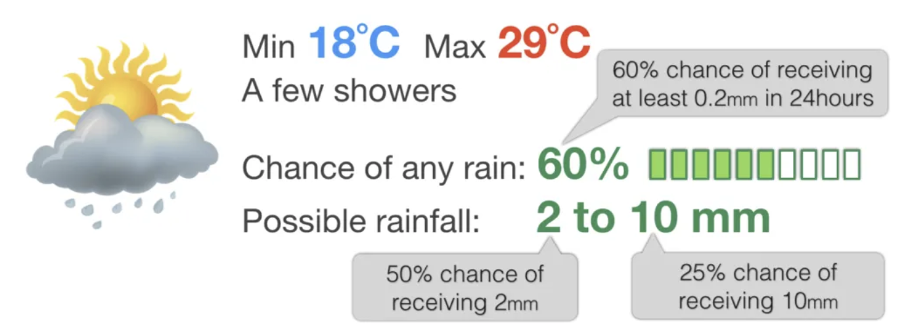
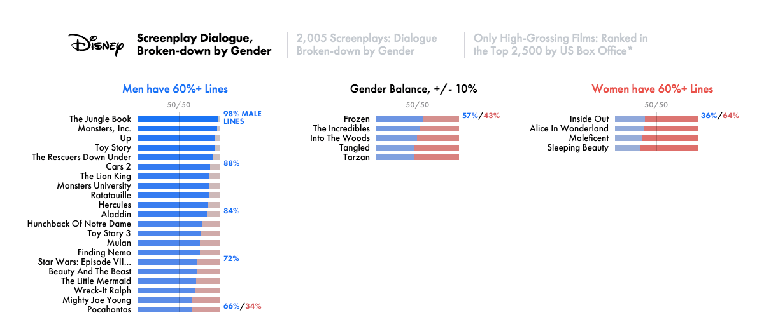

Slide 19
R Presentation
Here is how we can take data and organize it in a way that is easy to understand.
Demo here: Link to R Cloud

Slide 20
Data Set from the EPA
The following data set has two spreadsheets: one measuring AQI in Portland and the other in Los Angeles. It has data that was collected nearly everyday for 23 years.
What do you notice? What conclusions can you draw?
EPA Data
Source: https://www.epa.gov/outdoor-air-quality-data/air-data-tile-plot

Slide 21
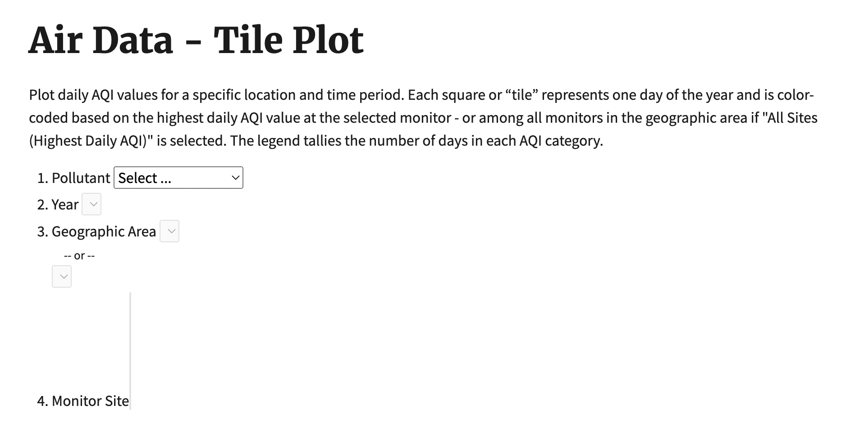
Try it yourself!

Slide 22
Data visualisation tells a story
Just by looking at the numbers, it can be hard to tell what the data is trying to tells us. There is a solution: Data visualization!
Using a graph where numbers are represented with lines is easier to understand.

Slide 23

What is this graph saying about the air quality is Portland within the last 23 years?
What patterns do you see?

Slide 24
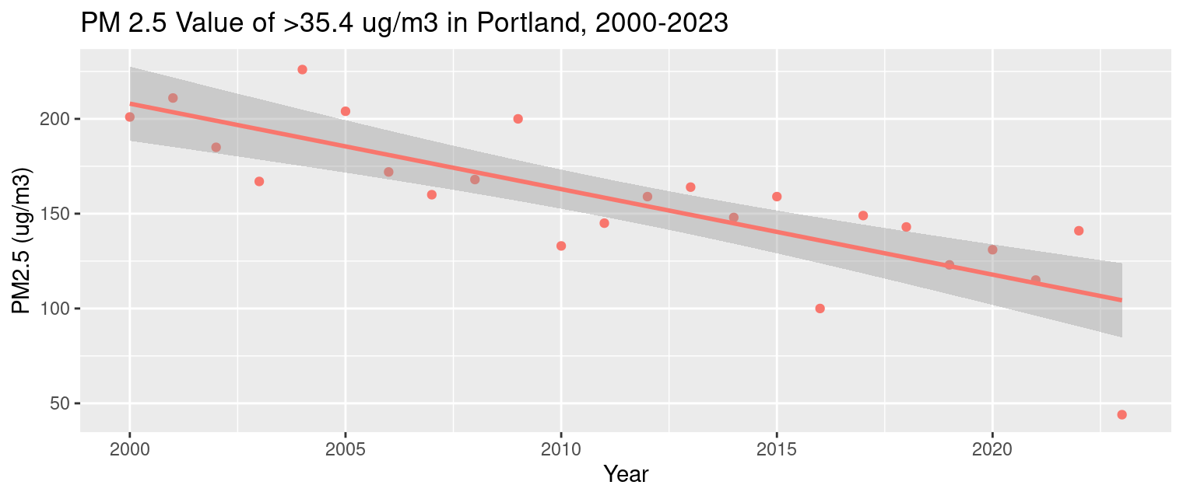
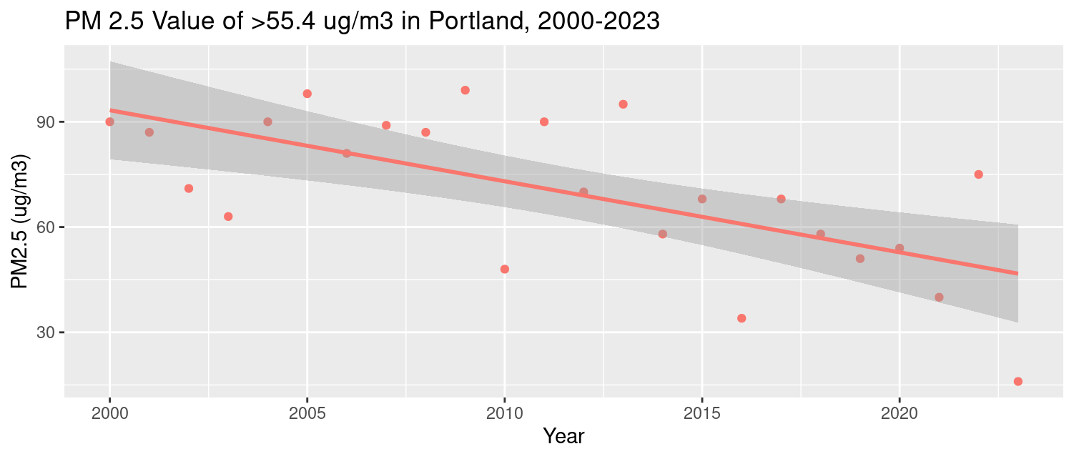
EPA visual of Particulate Matter 2.5
in Portland
Number of days per year where the PM 2.5 Value was above a certain threshold.

Slide 25
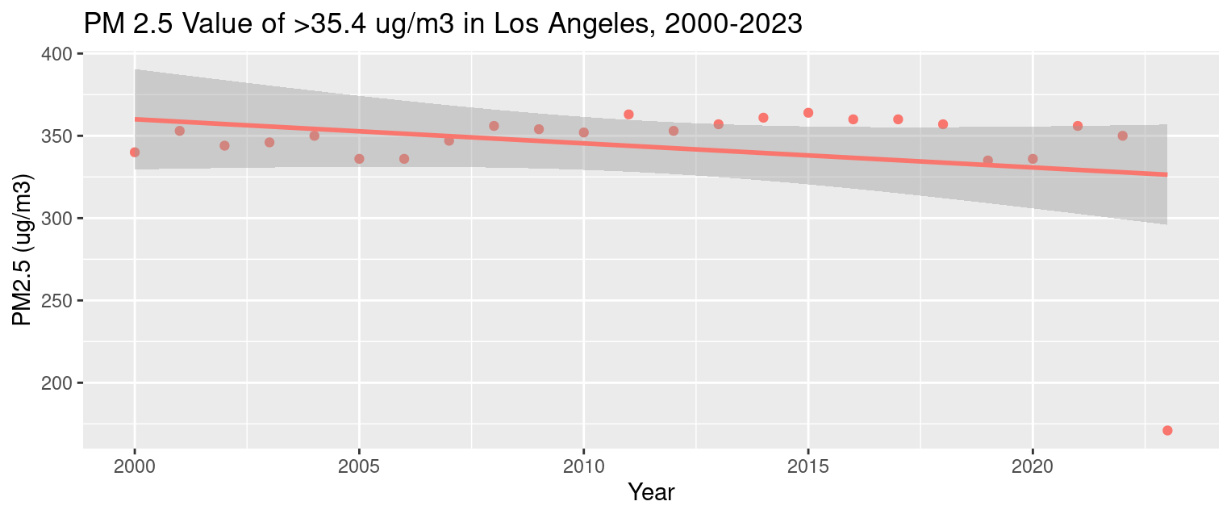
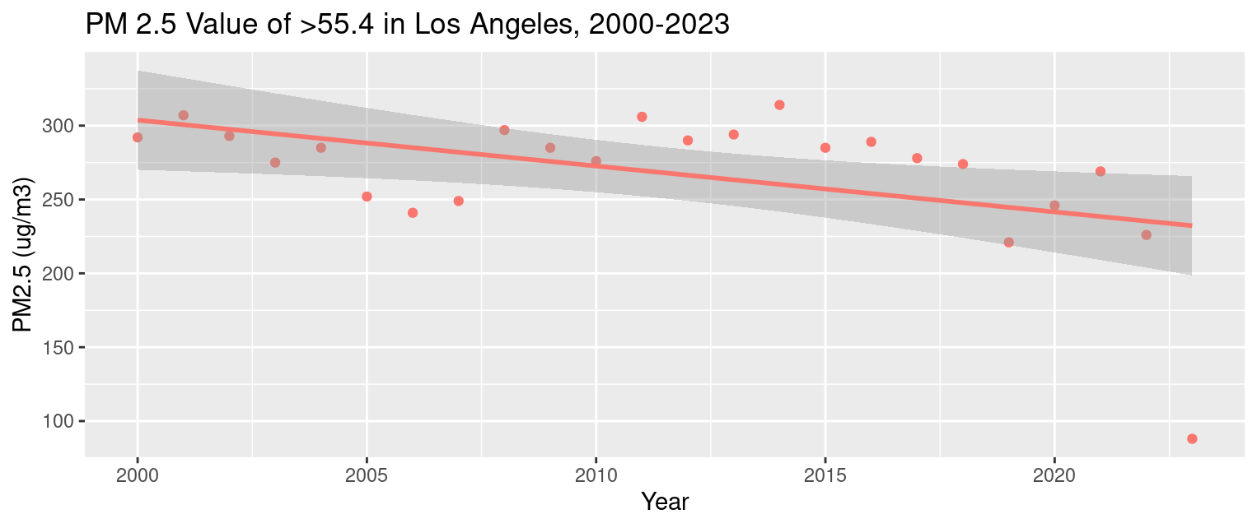
EPA visual of Particulate Matter 2.5
in Los Angeles
Number of days per year where the PM 2.5 Value was above a certain threshold.

Slide 26
When you see a graph, it’s important to look at the values and the kind of charts and ranges presented. The person who made the graph wants to tell you a story and you have to think critically about it.
A student at Lewis & Clark College took the raw data and made another tile plot using the same ranges and found a very different picture.

Slide 27
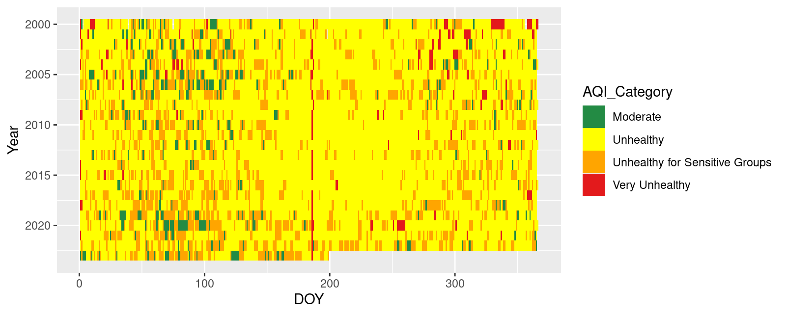
PDX accurate data

Slide 28
LA EPA Data
Let’s go back to the original LA graph made by the EPA software.
What do you think the accurate visualization will look like?

Slide 29
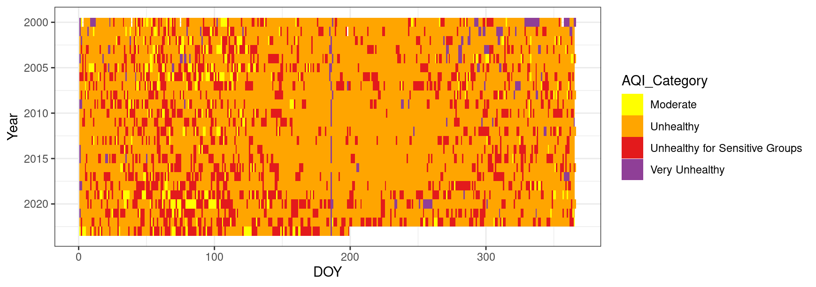
LA accurate data

Slide 30
Questions
What questions do you have about data science or data visualization?
If you were given the raw data, what other patterns would you like to look at?
Would you be interested in the AQI in other regions?

Slide 31
Wrapping Up: Talk with your group and be ready to share!
How did we use this huge data set to answer a specific question about air quality? Describe the steps.
Notes:
Teacher notes:
Encourage student discussion and collect responses here.

Slide 32
Wrapping Up: Talk with your group and be ready to share!
Do our results tell the story we expected? What did you expect compared to what we found?
Notes:
Teacher notes:
Encourage student discussion and collect responses here.

Slide 33
Wrapping Up: Talk with your group and be ready to share!
What other data would you want to help you answer questions about air quality?
Notes:
Teacher notes:
Encourage student discussion and collect responses here.

Slide 34
Wrapping Up: Talk with your group and be ready to share!
How can we apply what we learned about this process in our community?
Notes:
Teacher notes:
Encourage student discussion and collect responses here.

Slide 35
Extension: Explore the EPA data
Use this link to explore the AQI data from the EPA
Look up the data for any city
Consider
a place you have visited or would like to visit
a city in the southern hemisphere
What do you notice or wonder about that city’s AQI?

